Slide 1
Algorithms
Intro to Graph
DFS (revised)
Strongly Connected Components (SCC)

Slide 2
DFS in Directed Graphs
Run DFS on this graph
Mark all the vertices with discovery time and finish time
As you have marked finish time throw this vertex into the stack
As DFS ends you will have the vertices in an order that is finish time specific
A vertex having the maximum finish time will be at the top of the stack

Slide 3
DFS in Directed Graphs
G
H/2/3
Nil/1/-
Nil/1/-
1
2

Slide 4
DFS in Directed Graphs
H
G
Nil/5/-
H/2/3
H/2/3
Nil/1/4
Nil/1/4
4
3

Slide 5
DFS in Directed Graphs
F/7/-
H
G
Nil/5/-
Nil/5/-
E/6/-
E/6/-
H/2/3
H/2/3
Nil/1/4
Nil/1/4
5
6

Slide 6
DFS in Directed Graphs
F/7/8
F/7/8
F
B
H
G
Nil/5/-
Nil/5/-
E/6/9
E/6/-
H/2/3
H/2/3
Nil/1/4
Nil/1/4
8
7

Slide 7
DFS in Directed Graphs
F/7/8
F/7/8
E
F
B
H
G
Nil/5/10
Nil/5/10
E/6/9
E/6/9
Nil/11/-
H/2/3
H/2/3
Nil/1/4
Nil/1/4
9
10

Slide 8
DFS in Directed Graphs
F/7/8
D/12/-
A/13/-
F/7/8
D/12/-
E
F
B
H
G
Nil/5/10
Nil/5/10
E/6/9
Nil/11/-
E/6/9
Nil/11/-
H/2/3
H/2/3
Nil/1/4
Nil/1/4
12
11

Slide 9
DFS in Directed Graphs
F/7/8
D/12/-
A/13/14
F/7/8
D/12/15
A/13/14
A
C
E
F
B
H
G
Nil/5/10
Nil/5/10
E/6/9
Nil/11/-
E/6/9
Nil/11/-
H/2/3
H/2/3
Nil/1/4
Nil/1/4
13
14

Slide 10
DFS in Directed Graphs
F/7/8
D/12/15
A/13/14
D
A
C
E
F
B
H
G
Nil/5/10
E/6/9
Nil/11/16
H/2/3
Nil/1/4
15

Slide 11
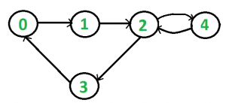

Strongly Connected Directed Graph
Two nodes u and v of a directed graph are strongly connected if there is a path from u to v and a path from v to u.
????
????
How to detect whether a given Directed graph is Strongly Connected Graph???

Slide 12
Strongly Connected Components in Directed Graphs
Two nodes u and v of a directed graph are connected if there is a path from u to v and a path from v to u.

Slide 13
Strongly Connected Components in Directed Graphs

Slide 14
Directed Graphs: How to find SCCs?

Slide 15
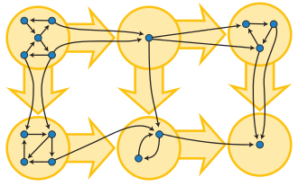
SCC (Another Example)

Slide 16
Find SCC in this graph just by seeing
Find the first SCC???

Slide 17
Find SCC in this graph just by seeing
Find the second SCC???

Slide 18
Find SCC in this graph just by seeing
Find the third SCC???

Slide 19
Find SCC in this graph just by seeing
Find the forth SCC???

Slide 20
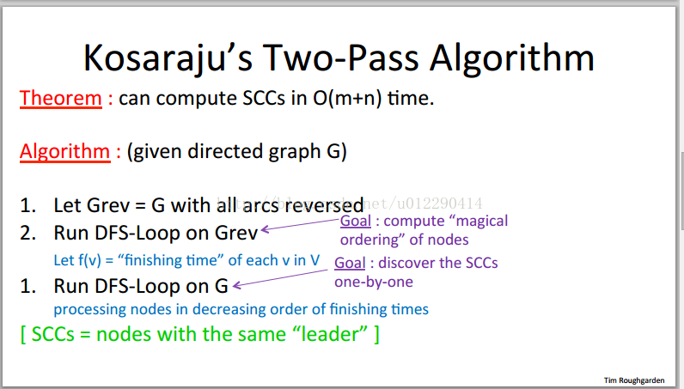
Directed Graphs: How to find SCCs?

Slide 21
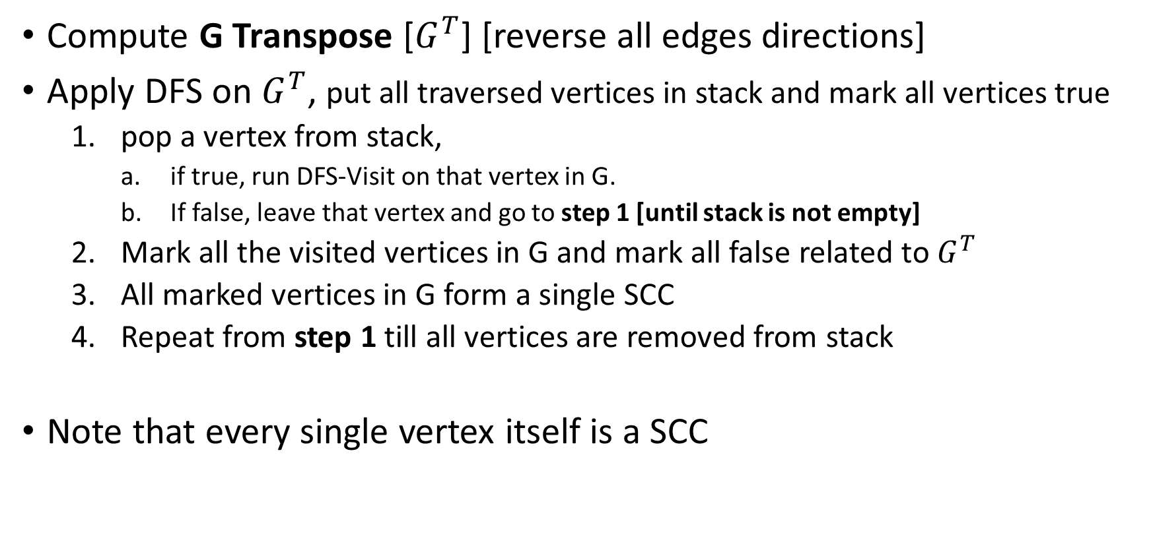
Finding SCC in Directed Graph
Compute G Transpose [$G^{T}$] [reverse all edges directions]
Apply DFS on $G^{T}$, put all traversed vertices in stack and mark all vertices true
pop a vertex from stack,
if true, run DFS-Visit on that vertex in G.
If false, leave that vertex and go to step 1 [until stack is not empty]
Mark all the visited vertices in G and mark all false related to $G^{T}$
All marked vertices in G form a single SCC
Repeat from step 1 till all vertices are removed from stack
Note that every single vertex itself is a SCC

Slide 22
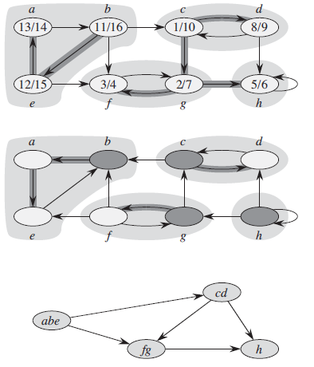

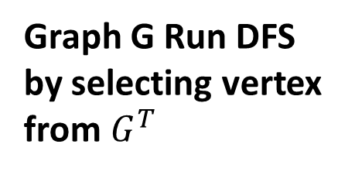
Pop the top vertex from stack, check if it is true, then start working from this vertex in G, otherwise check the next one in stack.
Graph $G^{T}$ Run DFS
b | T
e | T
a | T
c | T
d | T
g | T
h | T
f | T
Graph G Run DFS by selecting vertex from $G^{T}$
b is true
DAG – for SCC of the graph
Here (abc) is source
Here h is the sink

Slide 23
From b traverse in G
a, e are marked
So b, a, e are SCC in G
Graph $G^{T}$ Run DFS
e | F
a | F
c | T
d | T
g | T
h | T
f | T
Graph G Run DFS by selecting vertex from $G^{T}$
e is not true
DAG – for SCC of the graph
Here (abc) is source
Here h is the sink

Slide 24
Graph $G^{T}$ Run DFS
a | F
c | T
d | T
g | T
h | T
f | T
Graph G Run DFS by selecting vertex from $G^{T}$
a is not true
DAG – for SCC of the graph
Here (abc) is source
Here h is the sink

Slide 25
Graph $G^{T}$ Run DFS
c | T
d | T
g | T
h | T
f | T
Graph G Run DFS by selecting vertex from $G^{T}$
c is true
DAG – for SCC of the graph
Here (abc) is source
Here h is the sink

Slide 26
From c traverse in G
d is marked
So c, d are SCC in G
Graph $G^{T}$ Run DFS
d | F
g | T
h | T
f | T
Graph G Run DFS by selecting vertex from $G^{T}$
d is not true
DAG – for SCC of the graph
Here (abc) is source
Here h is the sink

Slide 27
Graph $G^{T}$ Run DFS
g | T
h | T
f | T
Graph G Run DFS by selecting vertex from $G^{T}$
g is true
DAG – for SCC of the graph
Here (abc) is source
Here h is the sink

Slide 28
From g traverse in G
f is marked
So g, f are SCC in G
Graph $G^{T}$ Run DFS
h | T
f | f
Graph G Run DFS by selecting vertex from $G^{T}$
h is true
DAG – for SCC of the graph
Here (abc) is source
Here h is the sink

Slide 29
From h traverse in G
No other vertex is marked
So h is single vertex SCC in G
Graph $G^{T}$ Run DFS
f | f
Graph G Run DFS by selecting vertex from $G^{T}$
f is not true
DAG – for SCC of the graph
Here (abc) is source
Here h is the sink

Slide 30
Graph $G^{T}$ Run DFS
Graph G Run DFS by selecting vertex from $G^{T}$
DAG – for SCC of the graph
Here (abc) is source
Here h is the sink

